Slide 1
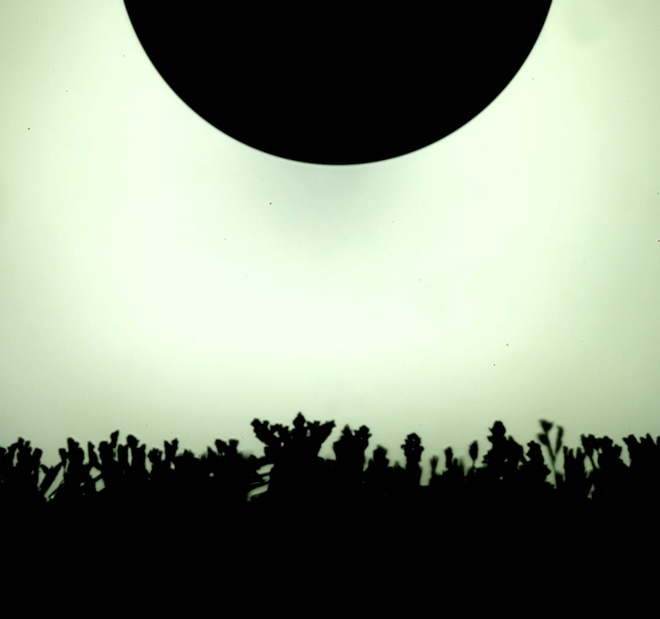
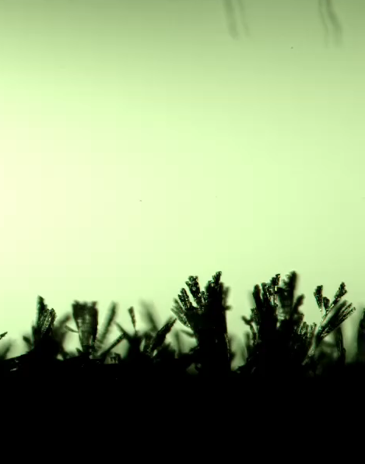
Water film
Water droplet
Straight path
Curved path
Played 317x slower
Played 250x slower

